Slide 1
Forget Me Not
Team Meeting
September 25th, 2019

Slide 2
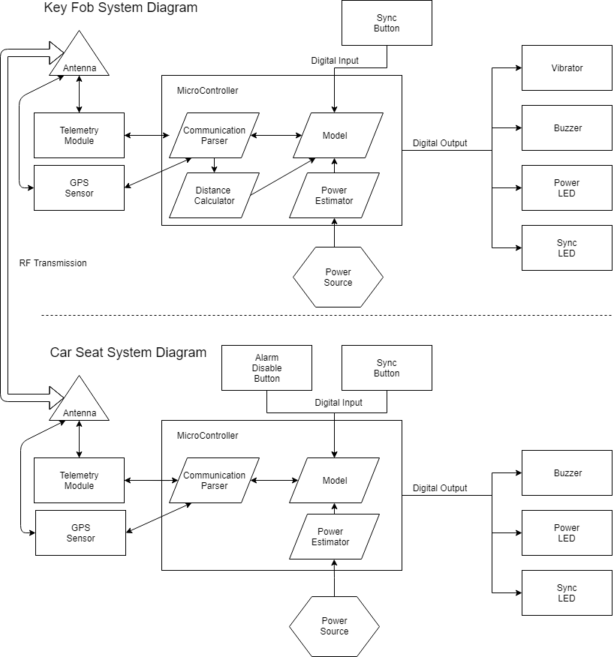
System Diagram
Major Components for Selection:
Telemetry Module/GPS
Digital I/O
Power Consumption/Monitoring

Slide 3
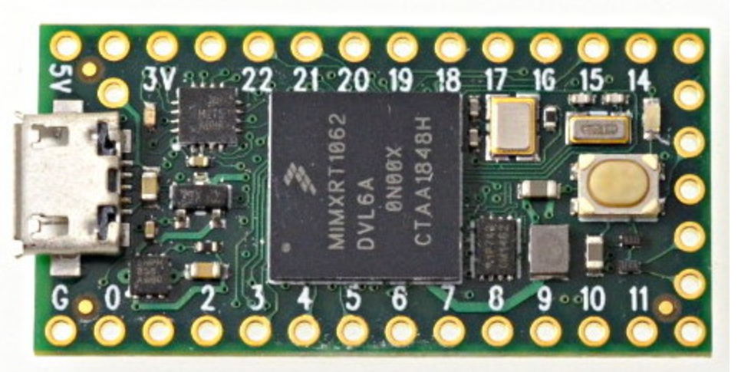
MicroController Selection
Teensy 4.0 Development Board
Selected for:
Size
Power Consumption
Voltage level
Number of I/O

Slide 4
Telemetry Module/GPS → Jacob
Telemetry Module
Ample Software Documentation
Capable of N-N Connection
Power Use
Preferably U.Fl Antenna Port
GPS Module
Power Use
Preferably U. Fl Antenna Port
Can these be packaged together?

Slide 5
Digital I/O → Raley
Digital I/O Requirements
Pushbuttons
LEDs
Vibrating/Audible Buzzer
Limiting Characteristics to conform to system requirements
Power usage
Voltage level
Physical size

Slide 6
Power Estimation → Mason
Looking up how circuits estimate battery charge.
Find ways to reduce power use.
Also research multiple options for compact power sources.
Single Cell Lithium
Button Battery

Slide 7
Plans for Next Meeting
Parts Discussion List for Selection

